Slide 1
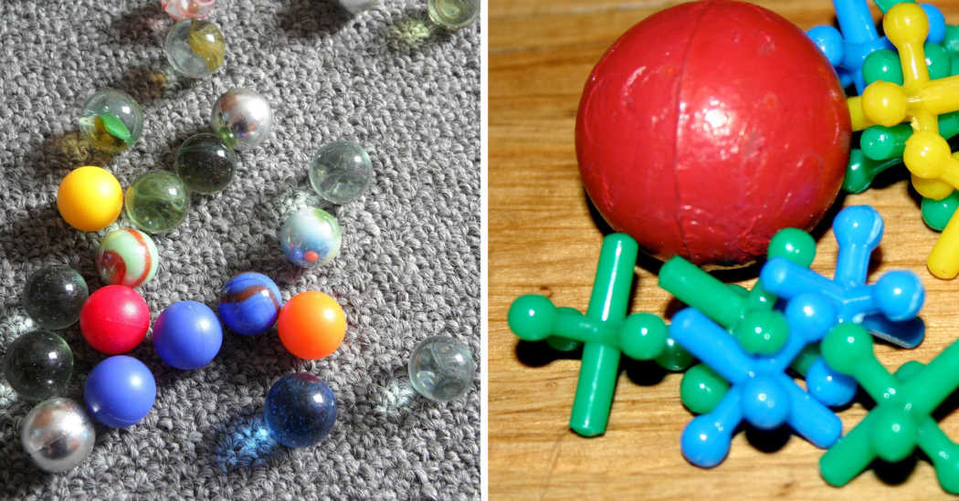
GAMES IN THE PAST

Slide 2
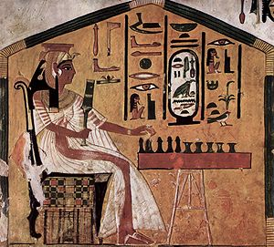
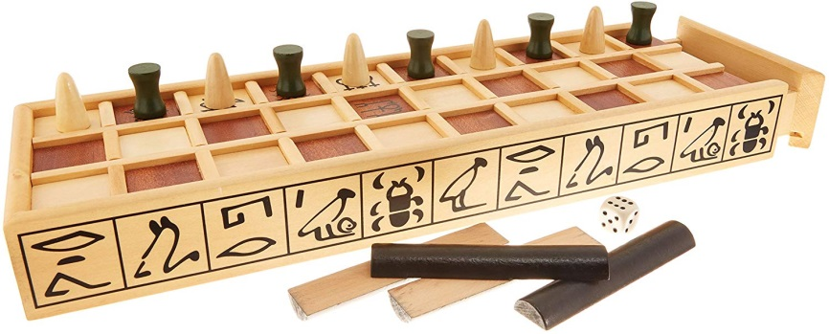
SENET
The senet is a board game devised in Ancient Egypt. It is one of the oldest board games that are known along with the oware (also called Wari) or the real Ur game, and its use was widespread in its time.
The goal of the senet is to take your pieces before the adversary, following a series of rules, advancing your own pieces, capturing and blocking the adversary.
Egyptian queen Nefertari playing senet.
Painting in his grave (13th century BC).

Slide 3
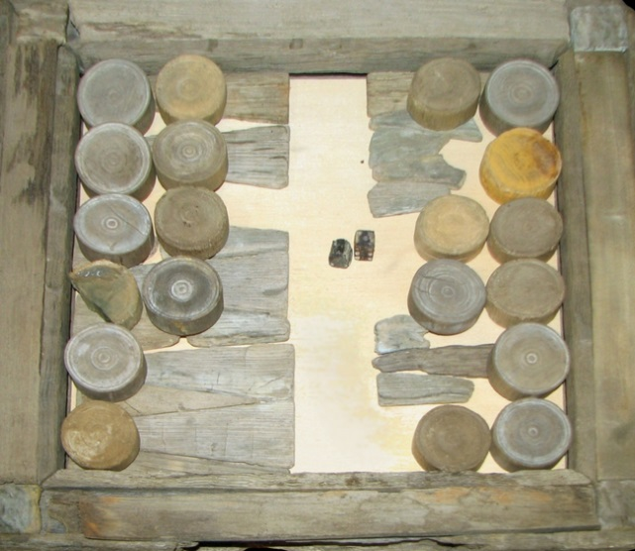
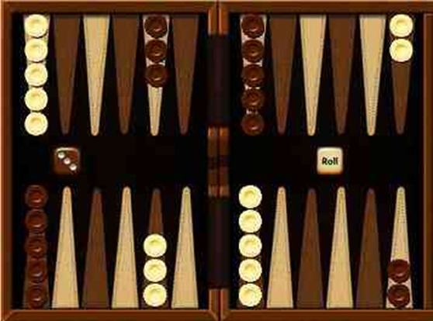
TAVLI
This game is one of the oldest games in existence, dating back almost 5000 years, and is believed to have been developed by the ancient Egyptians. Using 15 stones, two dice, one board and a winner's attitude, try to move your stones off the table before your opponent does.
The ancient Greeks played it. So did the Romans. The game we know today was refined in England in the seventeenth century, which is also when it acquired the name backgammon.

Slide 4
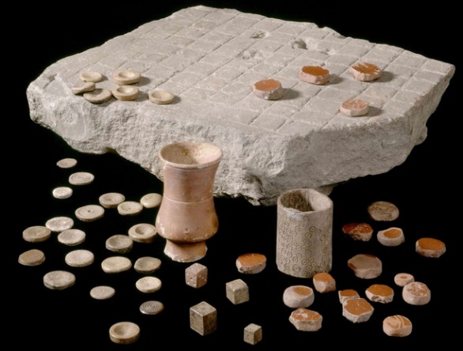
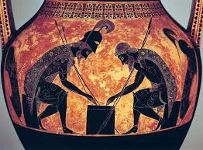
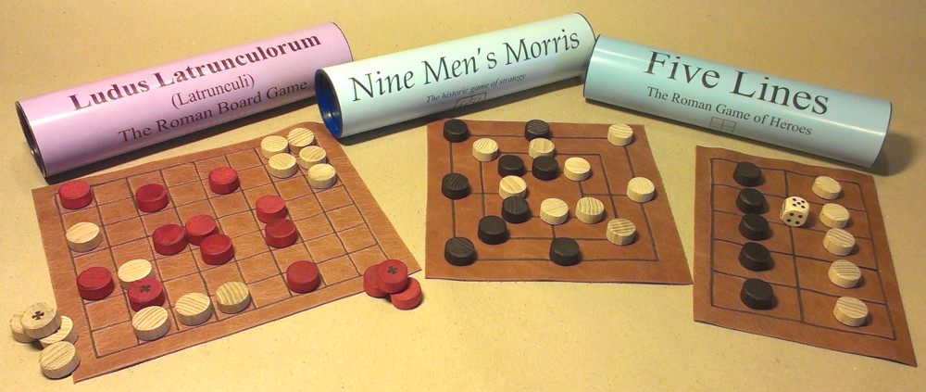
LUDUS LATRUNCULORUM
Ludus latrunculorum, literally "the game of thieves", also known simply as latrunculi or latrones (of latrunculus, diminutive of latro: mercenary or highwayman) is a board game practiced by the Romans. It is said that it was similar to checkers or chess, because it is also a game of military tactics.
The game played with many pieces is a board with spaces disposed among lines: the board is called the “city” and each piece is called a “dog;” the pieces are of two colors, and the art of the game consists in taking a piece of one color by enclosing it between two of the other color.

Slide 5
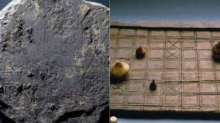
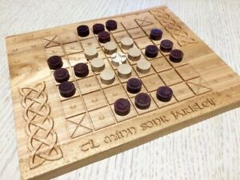
HNEFATAFL
Hnefatafl began its life in Scandinavia. It probably developed from a Roman war game called Ludus Latrunculorum, which in turn developed from petteia, a game of the Greeks. In its Scandinavian form, hnefatafl was taken through trade and invasion to the British Isles, to Iceland, France, Germany, Ukraine and to Greenland. In addition to many finds in its ancestral home, boards, pieces and literature for many variants have been found in diverse parts of northern Europe.
The game flourished until the arrival of chess.

Slide 6
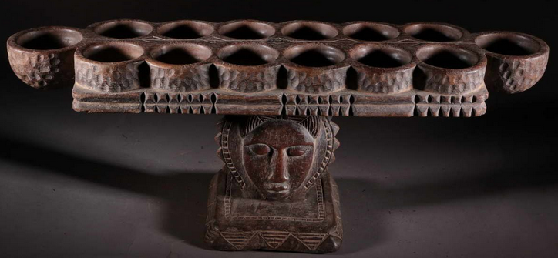
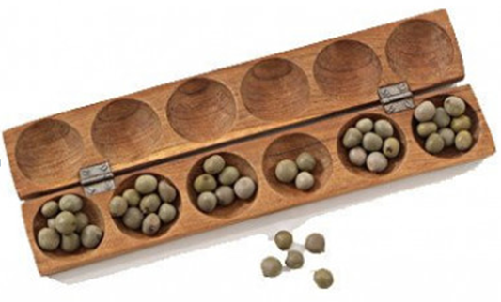
AWALÉ
Awalé is an ancestral game of African origin. There are sources that say it is the first board game in history.
In Africa we find hundreds of variants and in general all games of the same style are called Mancala.
This game if for two people; they sit opposite each other, next to both sides of the board. This board consists in two rows; each of the rows has six rows, and belongs to one of the players. The pieces are 48 seeds (any other little objects, like stones, may be used).
The aim of the game is simply to capture more seeds than the opponent. The winner is the player who obtains more than half of the seeds (25 or more seeds).

Slide 7


THANKS
SANDRA BELINDA ALCAIDE LASTRE
3º A ESO

